Slide 1
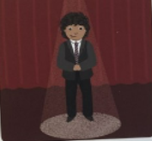
i_e
time to shine

Slide 2
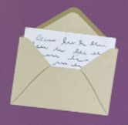
o_e
note in an envelope

Slide 3
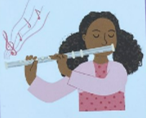
u_e
tune on a flute

Slide 4
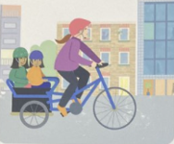
c
cycle through the city

