Slide 1
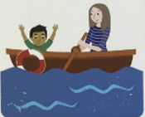
oy
a boy cries ‘ahoy’

Slide 2
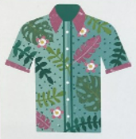
ir
a quirky shirt

Slide 3
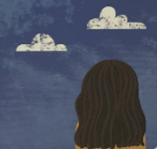
ue
true, the sky’s blue

Slide 4
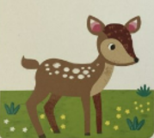
aw
a fawn on the lawn

