Slide 1
o
let’s both host

Slide 2
a
swallows and swans

Slide 3
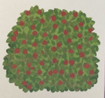
u
a bush full of berries

Slide 4
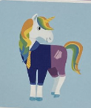
u
a unicorn in a uniform!

Slide 5
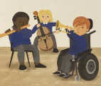
ch
the school orchestra

Slide 6
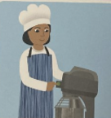
ch
the chef has a machine

Slide 7
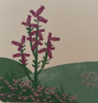
ea
heather in the meadow

