Slide 1
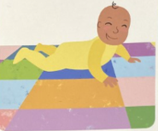
y
a lovely baby

Slide 2
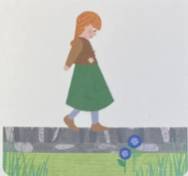
al
walk along the wall

