Slide 1
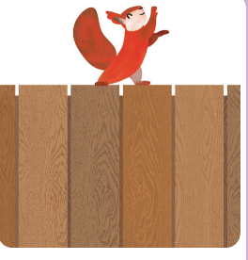
ce
Dance on the fence.

Slide 2
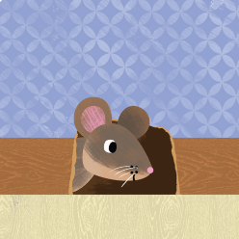
se
A mouse in the house.

Slide 3
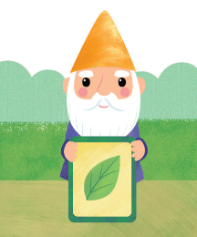
gn
A gnome with a sign.

Slide 4
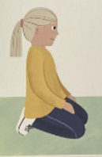
kn
Kneel on your knees.

Slide 5
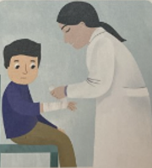
wr
wrap it round your wrist

Slide 6
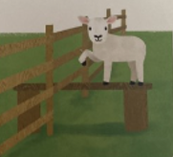
mb
the lamb climbed up

